Slide 1
Fundamentals of Programming
Prepared by: Zhuldyz Sultan
Examinator: Zhangir Rayev

Slide 2
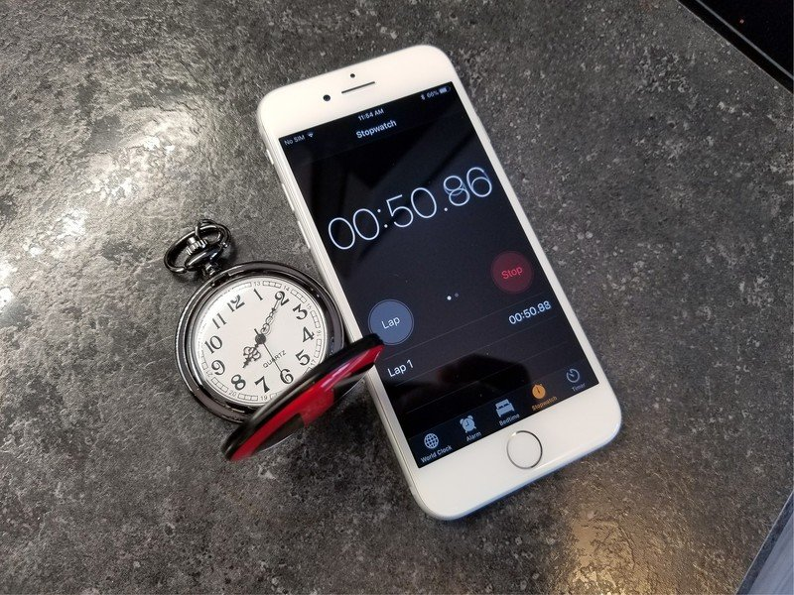
A stopwatch is a handheld timepiece designed to measure the amount of time that elapses between its activation and deactivation. A large digital version of a stopwatch designed for viewing at a distance, as in a sports stadium, is called a stop clock

Slide 3

Libraries
Tkinter is a Python package for working with the Tk library. The Tk library contains graphical user interface (GUI) components written in the Tcl programming language.
Graphical user interface (GUI) means all those windows, buttons, text fields for input, scrollers, lists, radio buttons, checkboxes that you see on the screen when you open an application.

Slide 4

A Counters is a container which keeps track to how many times equivalent values are added. Python counter class is a part of collections module and is a subclass of dictionary.
In Python, global keyword allows you to modify the variable outside of the current scope. It is used to create a global variable and make changes to the variable in a local context.
The count() is a built-in function in Python. It will return you the count of a given element in a list or a string. In the case of a string, the counting begins from the start of the string till the end.

Slide 5
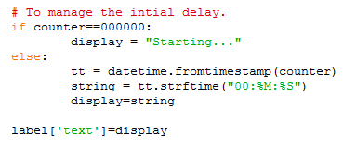
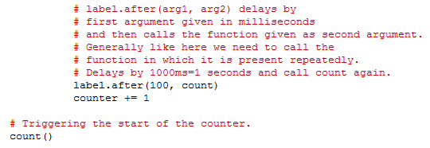
You can simply use the fromtimestamp function from the DateTime module to get a date from a UNIX timestamp. This function takes the timestamp as input and returns the corresponding DateTime object to timestamp.
The strftime() method returns a string representing date and time using date, time or datetime object.

Slide 6
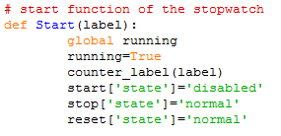
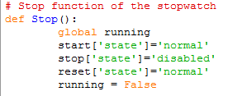

This function that starts the loop.
This is the function that stops the loop.
This is necessary for the cycle to start over.

Slide 7
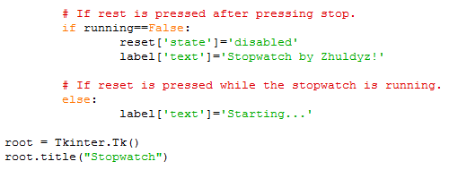
This command changes the title of the window
this command creates the root window of the program

Slide 8
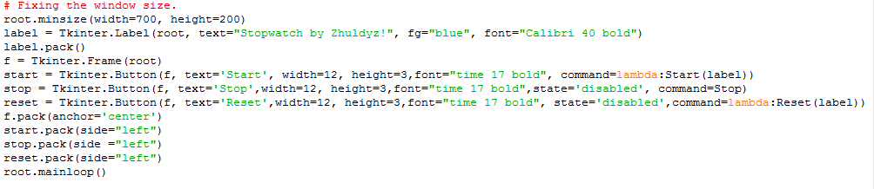
The Pack geometry manager packs widgets in rows or columns. We can use options like fill, expand, and side to control this geometry manager
The Button widget is used to add buttons in a Python application. These buttons can display text or images that convey the purpose of the buttons. You can attach a function or a method to a button which is called automatically when you click the button.

Slide 9
Thanks For Your Attention!!!

